Slide 1
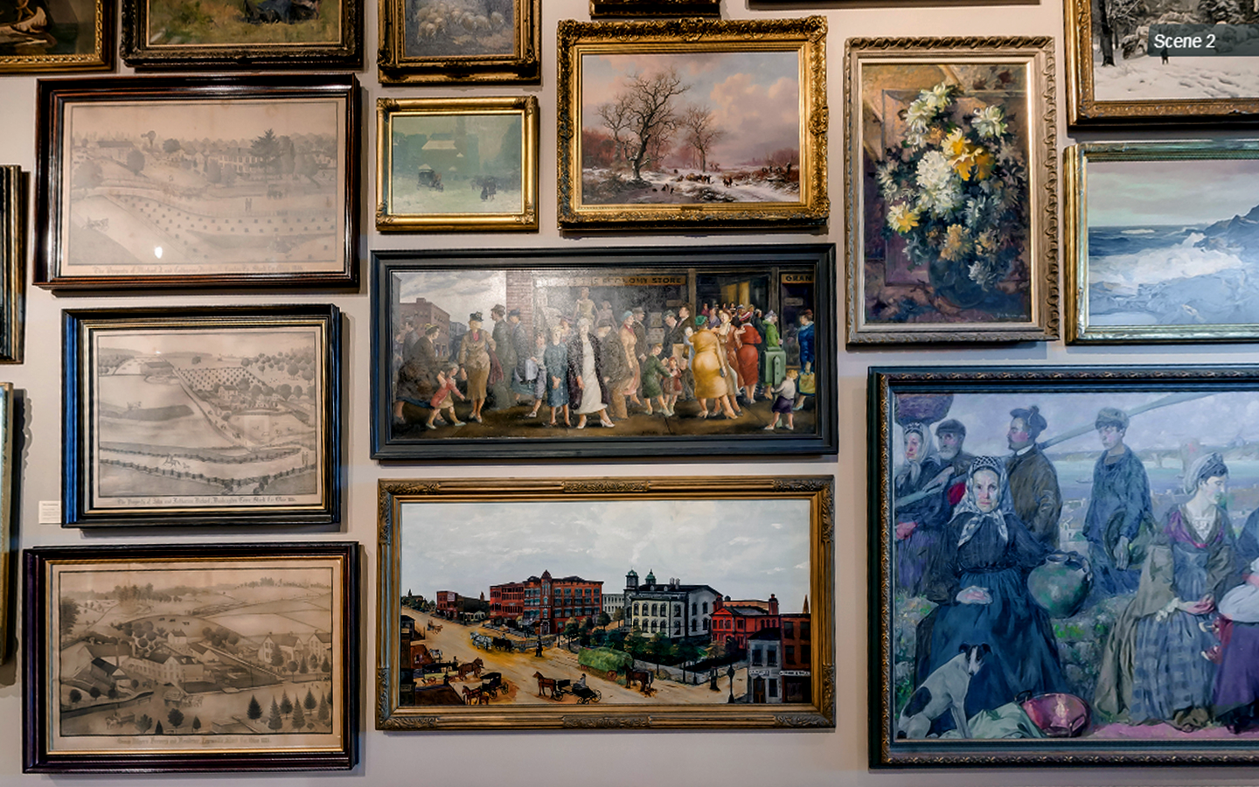

Slide 2
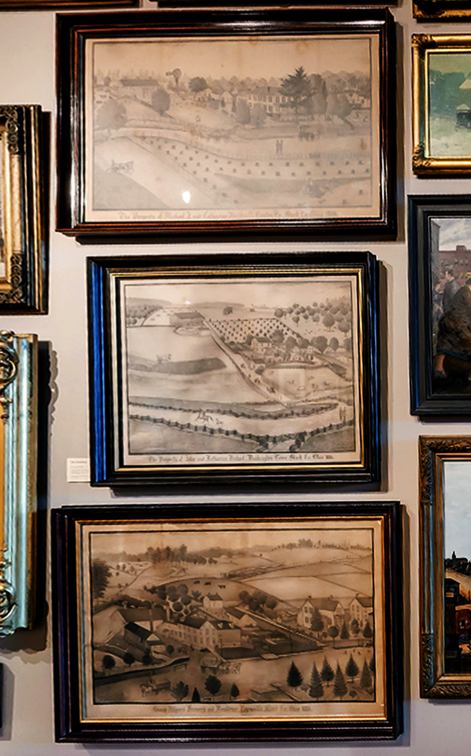
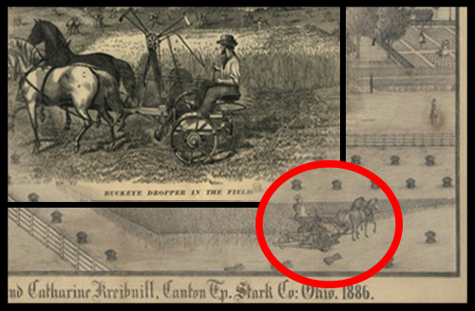

Slide 3
George Dilger's Brewery
Ferdinand A. Brader (1833-1901)
Drawing, 40”x58 ½” , 1885

Slide 4
The Property of Michael & Catharine Kreibuill, Canton Tp, Stark Co: Ohio 1886
Ferdinand A. Brader (1833-1901) Size: 31 1/2" x 48 3/4“ Date: 1886

Slide 5
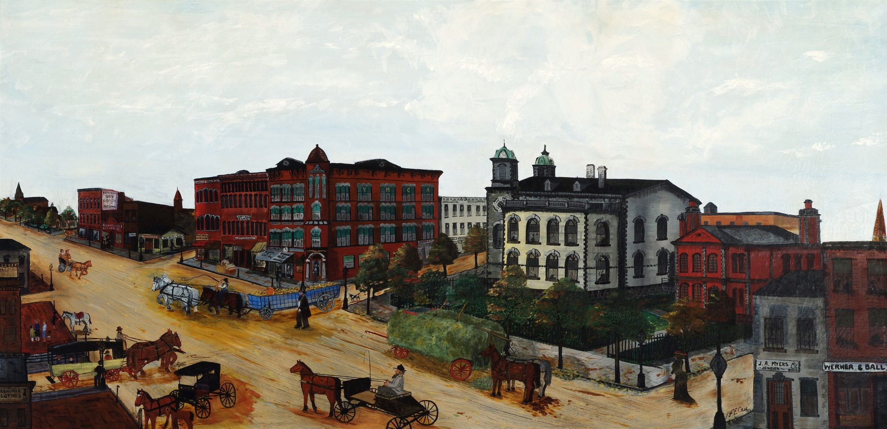
Early Canton
Frank E. Case Died 1933
Acquisition Number: 42.6 Medium: Oil Size: Date: Painted from Case’s memory of 1875

Slide 6
Street People
Clyde Singer 1908- 1999
Acquisition Number: 992.5 Medium: Oil Size: 37" x 82" Date: 1936
61 Years Later…

Slide 7
Attributed to Clyde Singer
People on the street
oil on canvas
14 x 28 in
Image from MutualArt Auction Site

Slide 8
Clyde Singer’s Sketching Process

Slide 9
The Final Painting!
Clyde Singer. Homecoming (Malvern) 1939. Oil. 45x57”
pg 68 and 69. Clyde Singer’s America by M.J. Albacete

Slide 10
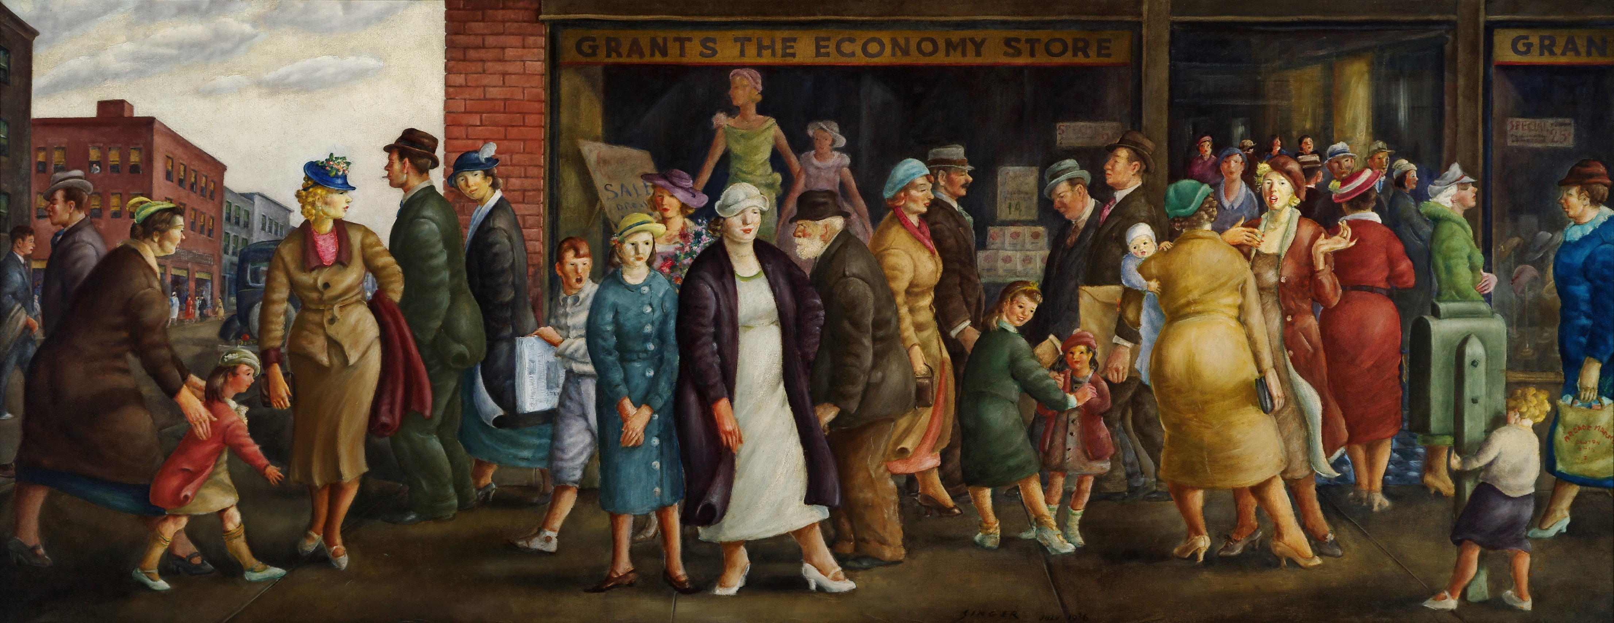

Slide 12
Street People
Clyde Singer 1908- 1999
Acquisition Number: 992.5 Medium: Oil Size: 37" x 82" Date: 1936

